Slide 1
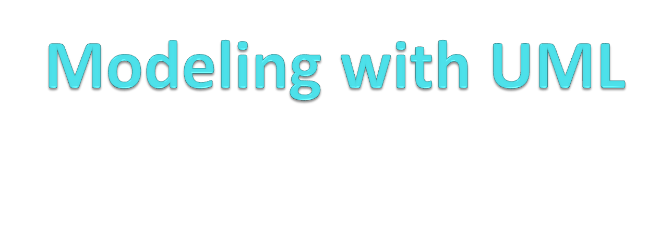

Slide 2
Overview: modeling with UML
What is modeling?
What is UML?
Use case diagrams
Class diagrams
Sequence diagrams
Activity diagrams
Dr.Thamer Al-Rousan

Slide 3
Why model software?
Why model software?
Software is getting increasingly more complex
  Windows > 40 million lines of code
  A single programmer cannot manage this amount of code in its entirety.
Code is not easily understandable by developers who did not write it
We need simpler representations for complex systems
  Modeling is a mean for dealing with complexity
Dr.Thamer Al-Rousan

Slide 4
What is modeling?
Modeling consists of building an abstraction of reality.
Abstractions are simplifications because:
  They ignore irrelevant details and
  They only represent the relevant details.
What is relevant or irrelevant depends on the purpose of the model.
Dr.Thamer Al-Rousan

Slide 5
Systems, Models and Views
A model is an abstraction describing a subset of a system
A view shows selected aspects of a model
A notation is a set of graphical or textual rules for representing views
Examples:
System: Aircraft
Models: Flight simulator, scale model
Views: All blueprints, electrical wiring, fuel system
Dr.Thamer Al-Rousan

Slide 6

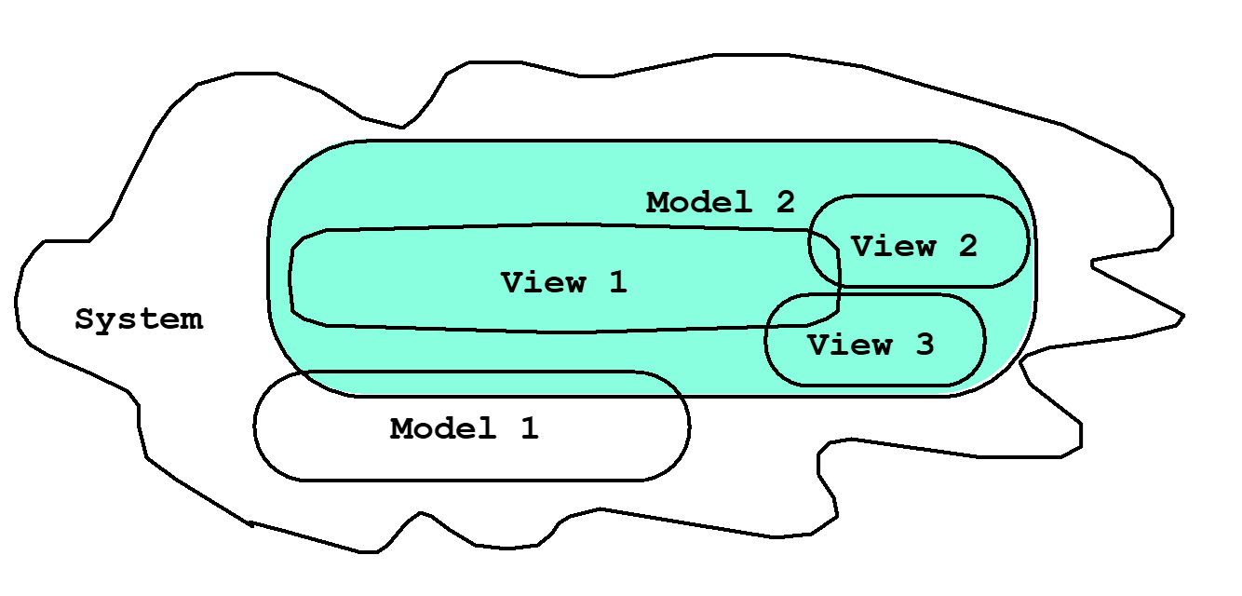
Systems, Models and Views
Flightsimulator
Blueprints
Aircraft
Electrical
Wiring
Scale Model
Dr.Thamer Al-Rousan

Slide 7
Models, Views and Systems (UML)
*
*
System
Model
View
Described by
Depicted by
Airplane: System
Scale Model: Model
Flight Simulator: Model
Blueprints: View
Fuel System: View
Electrical Wiring: View
Dr.Thamer Al-Rousan

Slide 8
What is software engineering?
  Software engineering is an engineering activity
  Software development typically includes five development activities: requirements elicitation, analysis, system design, object design, and implementation.
Dr.Thamer Al Rousan

Slide 9
Software Lifecycle Activities
...and their models
Requirements
Elicitation
Analysis
System
Design
Object
Design
Implemen-
tation
Testing
Implemented
By
Expressed in Terms Of
Structured By
Realized By
Verified
By
class...
class...
class...
?
class....
?
Use Case
Model
Application
Domain
Objects
Solution Domain
Objects
Subsystems
Source
Code
Test
Cases
Dr.Thamer Al Rousan

Slide 10
Application and Solution Domain
Application Domain (Requirements Analysis):
  The environment in which the system is operating
Solution Domain (System Design, Object Design):
  The available technologies to build the system
Dr.Thamer Al-Rousan

Slide 11
What is UML?
UML (Unified Modeling Language)
  An emerging standard for modeling object-oriented software.
  Resulted from the union of notations from three leading object-oriented methods:
    OMT (James Rumbaugh)
    OOSE (Ivar Jacobson)
    Booch (Grady Booch)
Reference: “The Unified Modeling Language User Guide”, Addison Wesley, 1999.
Supported by several CASE tools
  Rational ROSE
  TogetherJ
Dr.Thamer Al-Rousan

Slide 12
UML: First Pass
You can model 80% of most problems by using about 20 % UML
We teach you those 20%
Dr.Thamer Al-Rousan

Slide 13
UML First Pass
Use case Diagrams
  Describe the functional behavior of the system as seen by the user.
Class diagrams
  Describe the static structure of the system: Objects, Attributes, Associations
Sequence diagrams
  Describe the dynamic behavior between actors and the system and between objects of the system
Statechart diagrams
  Describe the dynamic behavior of an individual object (essentially a finite state automaton)
Activity Diagrams
  Model the dynamic behavior of a system, in particular the workflow (essentially a flowchart)
Dr.Thamer Al-Rousan

Slide 14
UML Core Rules
Rectangles are classes or instances
Ovals are functions or use cases
Instances are denoted with an underlined names
  myWatch:SimpleWatch
  Joe:Firefighter
Types are denoted with non underlined names
  SimpleWatch
  Firefighter
Diagrams are graphs
  Nodes are entities
  Arcs are relationships between entities
Dr.Thamer Al-Rousan

Slide 15
Use Case Modeling
Describe Behavior Of the system under development (i.e., what functionality must be provided by the system) is documented in a use case model
The most important role of a use case model is for communication between the customers or end users and the developers to discuss the system's functionality and behavior.
Dr.Thamer Al-Rousan

Slide 16
Use Case Diagrams
Used during requirements elicitation to represent external behavior
Actors represent any entity that is interacting with the system
Use cases represent a sequence of interaction for a type of functionality
The use case model is the set of all use cases. It is a complete description of the functionality of the system and its environment
Passenger
PurchaseTicket
Dr.Thamer Al-Rousan

Slide 17
Actors
An actor models an external entity which communicates with the system:
  User
  External system
  Physical environment
An actor has a unique name and an optional description.
Examples:
  Passenger: A person in the train
  GPS satellite: Provides the system with GPS coordinates
Passenger
Dr.Thamer Al-Rousan

Slide 18
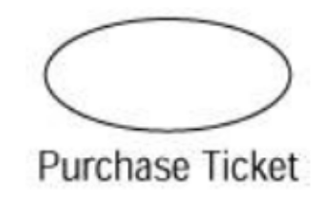
Use Case Modeling Concepts
Definition
  Use cases are high−level view of what the user expects from the system.
  Describes a task that a user can perform using the system.
  In other words, a use case illustrates how someone might use the system.
Description
  Describes requirements for the system
  Task described by a use case is composed of activities
  Use case can have different differences called scenarios
  Should not be used for functional decomposition !
  Use cases focus on what the system should do, not how the system will do it.
  Your collection of use cases should let the customers easily see, at a very high level, your entire system.
  Use cases are written in natural language.
  A use case is represented by this symbol:
Dr.Thamer Al-Rousan
Notes:
Use cases take a different approach than traditional methods. Splitting the project into use cases is a process−oriented, not an implementation−oriented, way of looking at the system. It is therefore different from the functional decomposition approach that is so often taken. While functional decomposition focuses on how to break the problem down further and further into pieces that the system will handle, the use case approach focuses first on what the user expects from the system.
First Use cases focus on what the system should do, not how the system will do it. We'll get into the how later on in
the process.
Secondly, the use cases are a high−level view of the system. Your collection of use cases should let the
customers easily see, at a very high level, your entire system. There should not be so many use cases that the
customer is forced to wade through pages and pages of documentation just to see what the system will do. At
the same time, there should be enough use cases to completely describe what the system will do. A typical
system will have somewhere between 20 and 70 use cases. (If your system has 3000 use cases, you've lost the
benefit of simplicity.)
Finally, the use cases should be focused on what the user will get out of the system. Each use case should
represent a complete transaction between the user and the system that results in something of value to the
user. The use cases should be named in user terms, not technical terms, and should be meaningful to the
customer. We wouldn't have a use case, for example, called "Interface with the Bank's Credit System to
Validate the Credit Card Number." The customer is trying to purchase a ticket, so that's what we call the use
case: "Purchase Ticket." Use cases are typically named with verbs or short verb phrases in the format "<verb>
<noun>," and describe what the customer sees as the end result. The customer doesn't care how many other
systems you have to interface with, what specific steps need to be taken, or how many lines of code you need
to confirm a Visa card. That customer cares only that a ticket was purchased. Again, you focus on the result
the user expects from the system, not the steps that were taken to achieve the result.
We can see from our brief vision statement above that it will let users purchase tickets, change a
reservation, or cancel a reservation. These are all good candidates for use cases; each is some piece of
functionality the system will provide that is of value to the end user. Notice that we didn't include a use case,
such as "Get Flight Information" from the legacy system. This is a behind−the−scenes piece of logic that the
end user really doesn't care about, so it doesn't qualify as a use case. "Purchase Ticket," "Change
Reservation," or "Cancel Reservation," on the other hand, are things that the end user would care about and
high−level pieces of functionality the system will provide, so they are good use cases

Slide 19
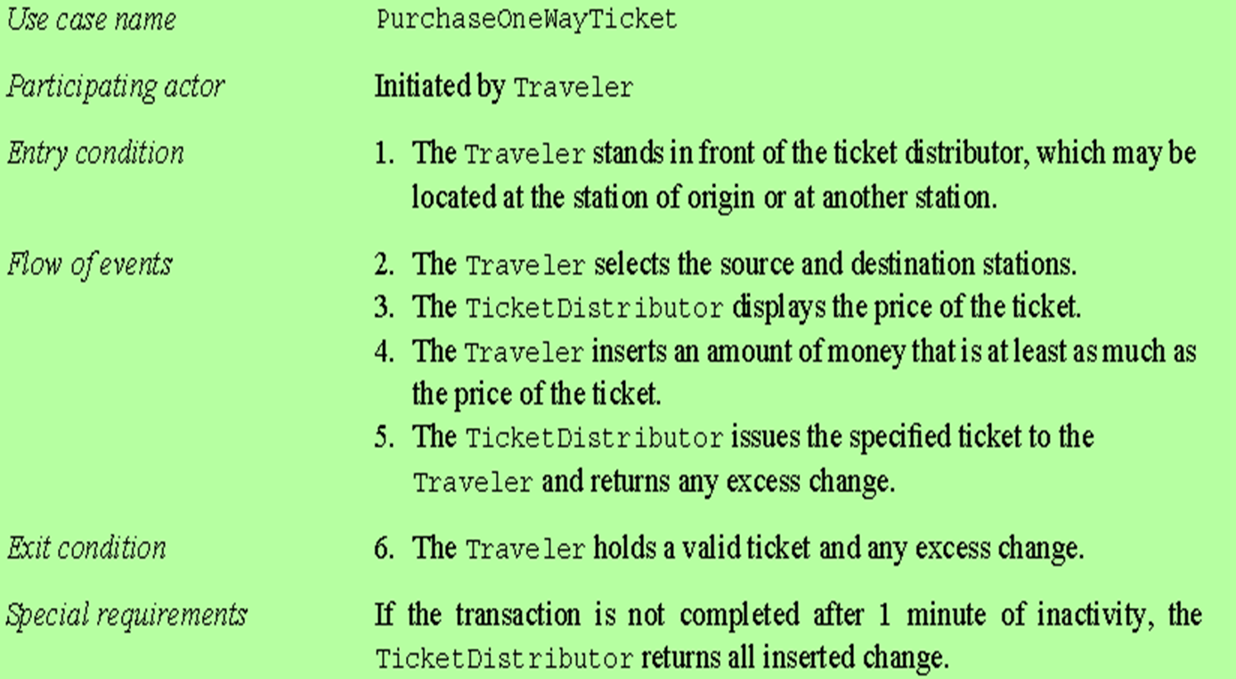
An example of Use Case
Dr.Thamer Al-Rousan

Slide 20
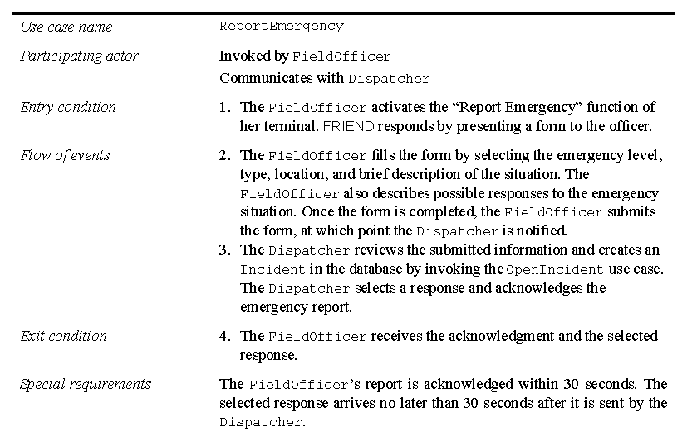
An example of Use Case
Dr.Thamer Al-Rousan

Slide 21
Scenario
A use case is abstraction that describe all possible scenarios involving to describe functionality
Scenario is instance is use case to describe part of use case
Scenario is used to describe common part of use case
Scenario focus on understandability
Use case focus on completeness
Scenario include:
  Scenario name ( the name of a scenario is underlined to indicate that it is instance)
  Participant actors (underlined )
  Flow of event
No need for entry and exit conditions because a scenario only describes a single flow of events.
Dr.Thamer Al-Rousan

Slide 22
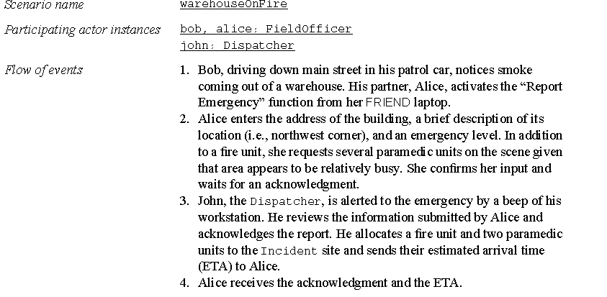
An example of Scenario
Dr.Thamer Al-Rousan

Slide 23
Use case
Identification of actor and use case result in the identification of the boundary of the system:
  Actor is outside of the boundary of the system
  Use case is inside boundary of the system
Actor initiate a use case to access system functionality
Use case can initiate other use cases and gather information from actors
Dr.Thamer Al-Rousan

Slide 24
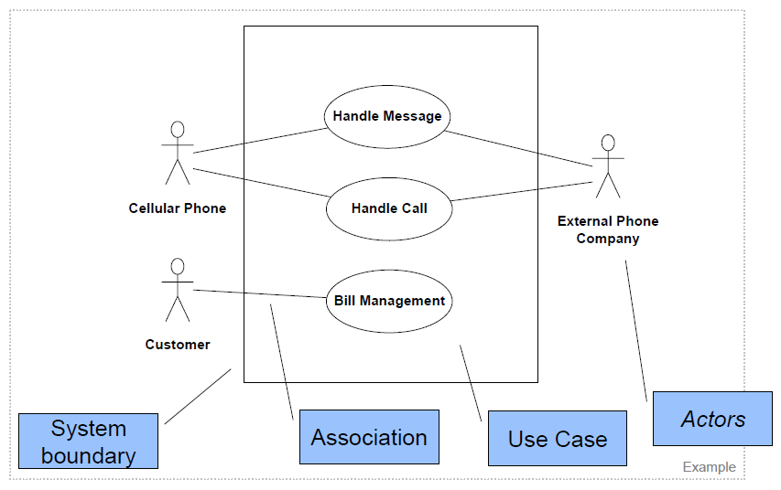
Notes:
Use case diagrams

Slide 25

Lack of ambiguity
- Each requirement must be interpreted in a single manner.
Completeness
- The collection of all use cases is everything that can be done to/with the system.
Consistency
- Requirements should not conflict with each other. If there are, tradeoffs must be detected and discussed.
Avoid design
- Requirements should raise a need, not answer it.
Notes:
sipdroid

Slide 26
Extend relationships
Extend relationships are for reducing complexity in the use case model.
A use case can extend another use case by adding events.
  An extend relationship indicates that an instance of an extended use case may include (under certain conditions) the behavior specified by the extending use case.
A typical application of extend relationships is the specification of exceptional behavior.
In the textual representation of a use case, we represent extend relationships as entry conditions of the extending use case.
Dr.Thamer Al-Rousan

Slide 27
The <<extends>> Relationship
<<extends>> relationships represent exceptional or seldom invoked cases.
The exceptional event flows are factored out of the main event flow for clarity.
Use cases representing exceptional flows can extend more than one use case.
The direction of a <<extends>> relationship is to the extended use case
Passenger
PurchaseTicket
<<extends>>
<<extends>>
<<extends>>
OutOfOrder
<<extends>>
TimeOut
Cancel
NoChange
Dr.Thamer Al-Rousan

Slide 28
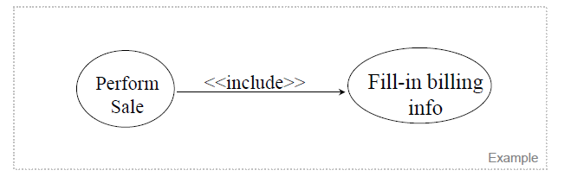
include relationships
When describing a complex system, its use case model can become quite complex and can contain redundancy.
We reduce the complexity of the model by identifying commonalities in different use cases.
  Two use cases are related by an include relationship if one of them includes the second one in its flow of events.
  In UML, include relationships are depicted by a dashed arrow originating from the including use case<<include>>
Dr.Thamer Al-Rousan

Slide 29
The <<includes>> Relationship
<<includes>> relationship represents behavior that is factored out of the use case.
<<includes>> behavior is factored out for reuse, not because it is an exception.
The direction of a <<includes>> relationship is to the using use case (unlike <<extends>> relationships).
Passenger
PurchaseMultiCard
PurchaseSingleTicket
<<includes>>
<<includes>>
<<extends>>
CollectMoney
<<extends>>
NoChange
Cancel
Dr.Thamer Al-Rousan

Slide 30
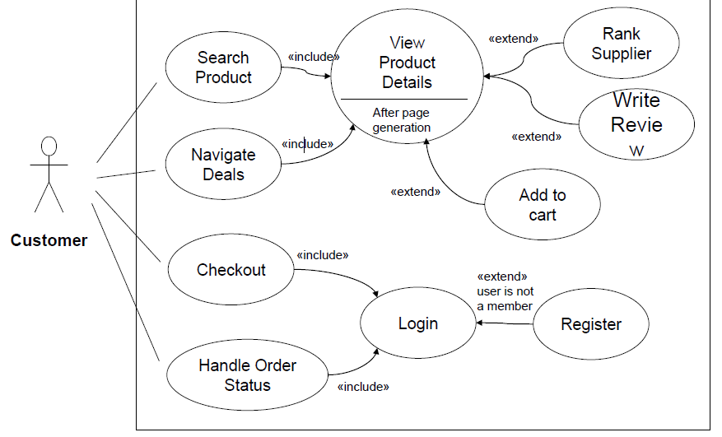

Slide 31

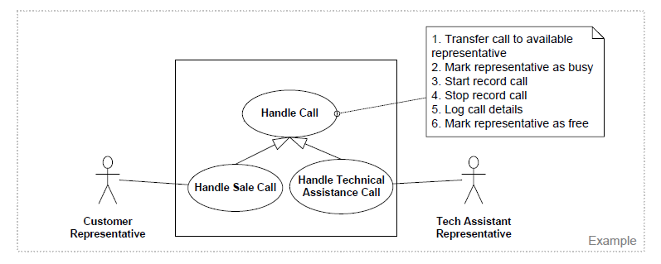
use case may have common behaviors, requirements, constraints, and assumptions with a more general use case.

Slide 32
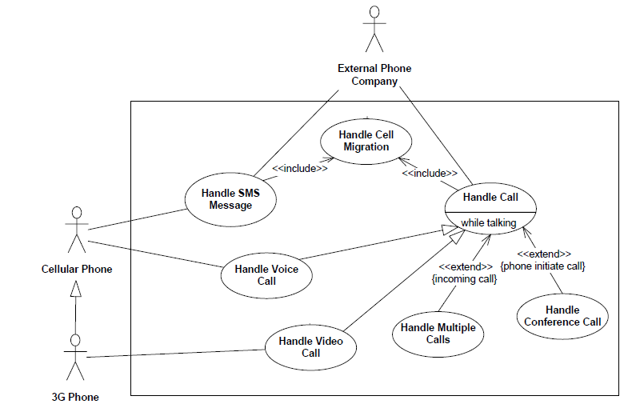

Slide 33
Use Case Modeling Concepts - Advantage
The advantage of looking at a system with use cases
  Is the ability to separate the implementation of the system from the reason the system is there in the first place.
  It helps you focus on what is truly important—meeting the customer's needs and expectations without being instantly overwhelmed by implementation details.
  By looking at the use cases, the customer can see what functionality will be provided, and can agree to the system scope before the project goes any further.
Dr.Thamer Al-Rousan

Slide 34
Use Case Diagrams: Summary
Use case diagrams represent external behavior
Use case diagrams are useful as an index into the use cases
Use case descriptions provide meat of model, not the use case diagrams.
All use cases need to be described for the model to be useful.
Dr.Thamer Al-Rousan

Slide 35
Concepts and Phenomena
Phenomenon
  An object in the world of a domain as you perceive it
  Example: The lecture you are attending
  Example: My black watch
Concept
  Describes the properties of phenomena that are common.
  Example: Lectures on software engineering
  Example: Black watches
Concept is a 3-tuple:
  Name (To distinguish it from other concepts)
  Purpose (Properties that determine if a phenomenon is a member of a concept)
  Members (The set of phenomena which are part of the concept)
Dr.Thamer Al-Rousan

Slide 36
Concepts and phenomena
Purpose
Members
Name
Clock
A device that
measures time.
Abstraction
  Classification of phenomena into concepts
Modeling
  Development of abstractions to answer specific questions about a set of phenomena while ignoring irrelevant details.
Dr.Thamer Al-Rousan

Slide 37
Concepts in software: Type and Instance
Type:
  An abstraction in the context of programming languages
  Name: int, Purpose: integral number, Members: 0, -1, 1, 2, -2, . . .
Instance:
  Member of a specific type
The type of a variable represents all possible instances the variable can take
The following relationships are similar:
  “type” <–> “instance”
  “concept” <–> “phenomenon”
Dr.Thamer Al-Rousan

Slide 38
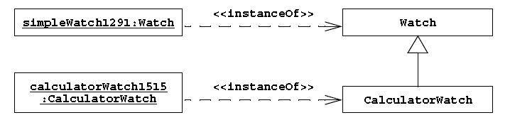
Object
An object is an instance of a class.
  An entity that corresponds to something in the real world.
An object has an identity and stores attribute values.
Each object belongs to exactly one class. In UML, an instance is described by a rectangle with its name underlined.
Dr.Thamer Al-Rousan

Slide 39
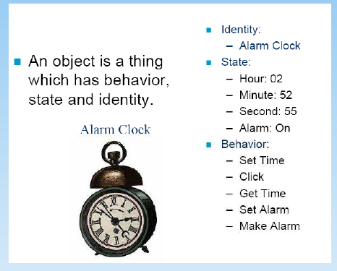
Object
Dr.Thamer Al-Rousan

Slide 40
Classes
Class diagrams describe the structure of the system in terms of objects, classes.
Objects are example of classes.
Objects have state that includes the values of its attributes and its relationships with other objects.
Classes are abstractions that specify the common structure and behavior of a set of objects.
Dr.Thamer Al-Rousan

Slide 41
Essentials of UML Class Diagrams
The main symbols shown on class diagrams are:
  Classes
      represent the types of data themselves
  Associations
      represent linkages between instances of classes
  Attributes
      are simple data found in classes and their instances
  Operations
      represent the functions performed by the classes and their instances
  Generalizations
      group classes into inheritance hierarchies
Dr.Thamer Al-Rousan

Slide 42
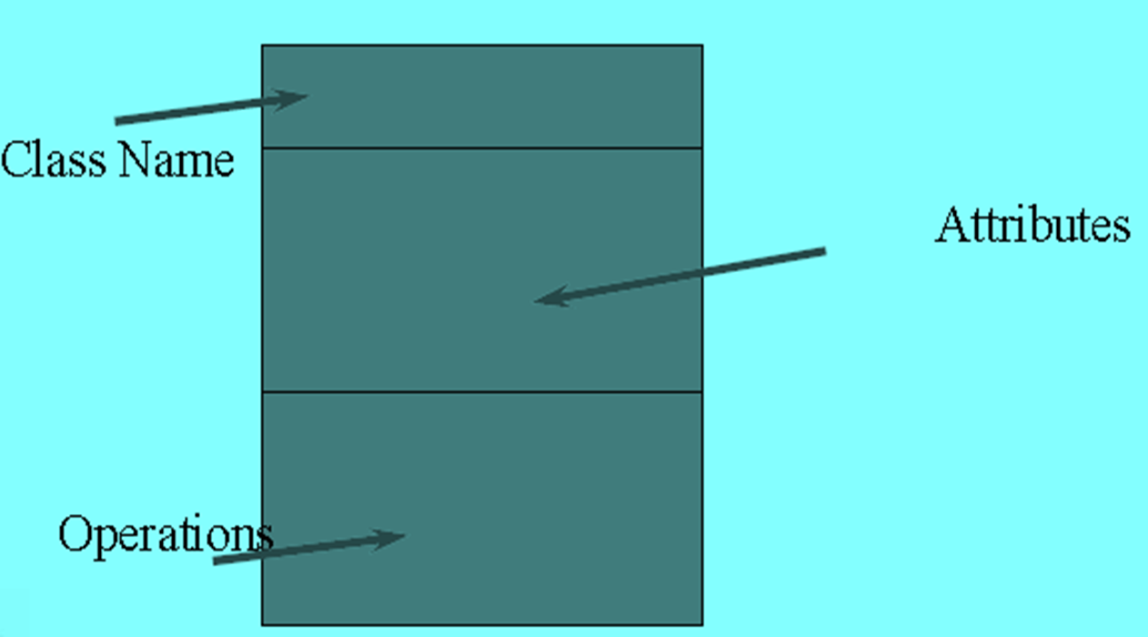
Representing UML Classes
Dr.Thamer Al-Rousan

Slide 43
Classes
TarifSchedule
Table zone2price
Enumeration getZones()
Price getPrice(Zone)
Name
TarifSchedule
Attributes
Signature
zone2price
getZones()
getPrice()
Operations
TarifSchedule
A class represent a concept
A class encapsulates state (attributes) and behavior (operations).
Each attribute has a type.
Each operation has a signature.
The class name is the only mandatory information.

Slide 44
Naming Class
Naming Classes
  Class names should be singular nouns
  Class names should come directly from the problem domain
  If you cannot think of a name then there may be a problem with the design
Dr.Thamer Al-Rousan

Slide 45
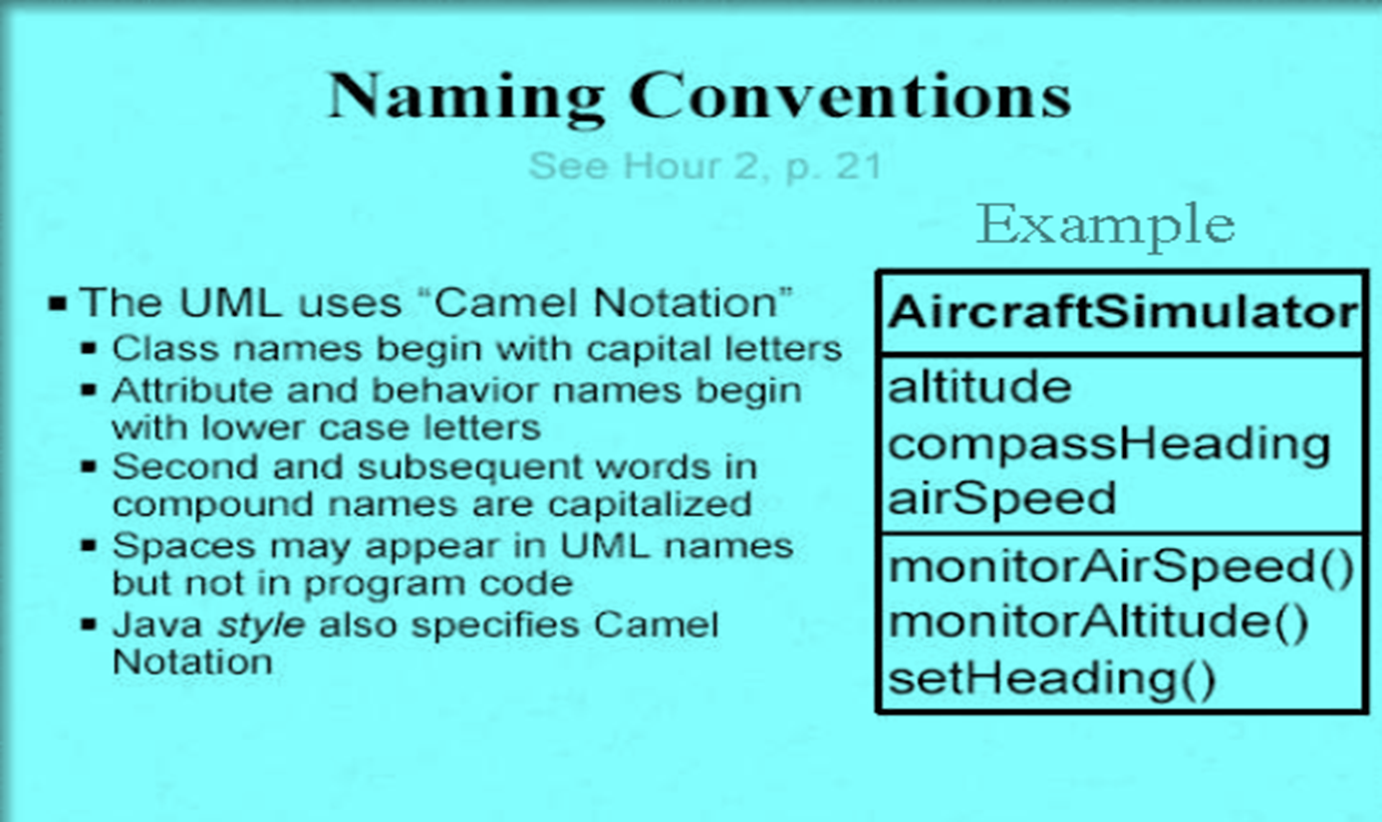
Naming Class
Dr.Thamer Al-Rousan

Slide 46
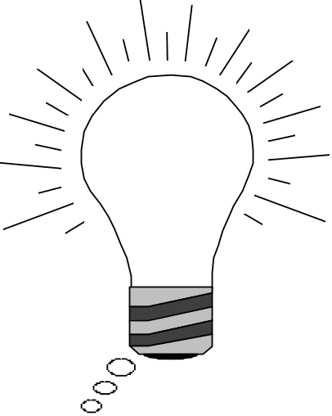
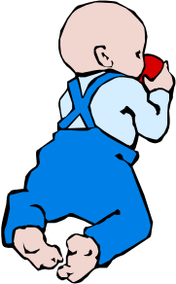
Object Modeling in Practice:
Encourage Brainstorming
“Dada”
Foo
Betrag
Betrag
CustomerId
CustomerId
Deposit()
Deposit()
Withdraw()
Withdraw()
GetBalance()
GetBalance()
Account
Betrag
CustomerId
Deposit()
Naming is important!
Is Foo the right name?
Withdraw()
GetBalance()
Dr.Thamer Al-Rousan

Slide 47
Representing UML Classes
It is acceptable to show a class as :
  a class name only;
  a class name and a list of attributes;
  a class name and a list of operations;
  a class name, a list of attributes and a list of operations
Dr.Thamer Al-Rousan

Slide 48
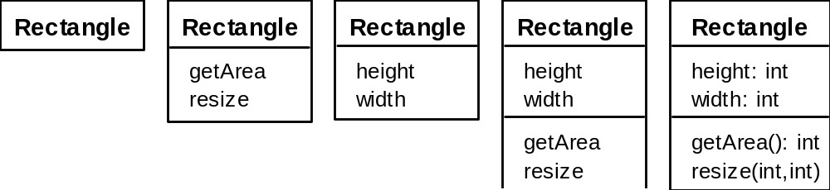
Classes
A class is simply represented as a box with the name of the class inside
  The diagram may also show the attributes and operations
  The complete signature of an operation is:
Dr.Thamer Al-Rousan

Slide 49
Instances
tarif_1974:TarifSchedule
zone2price = {
{‘1’, .20},
{‘2’, .40},
{‘3’, .60}}
An instance represents a phenomenon.
Objects in object diagrams may be given names (followed by their class) for ease of reference.
their name starts with a lowercase letter.
The name of an instance is underlined
The attributes are represented with their values.

Slide 50
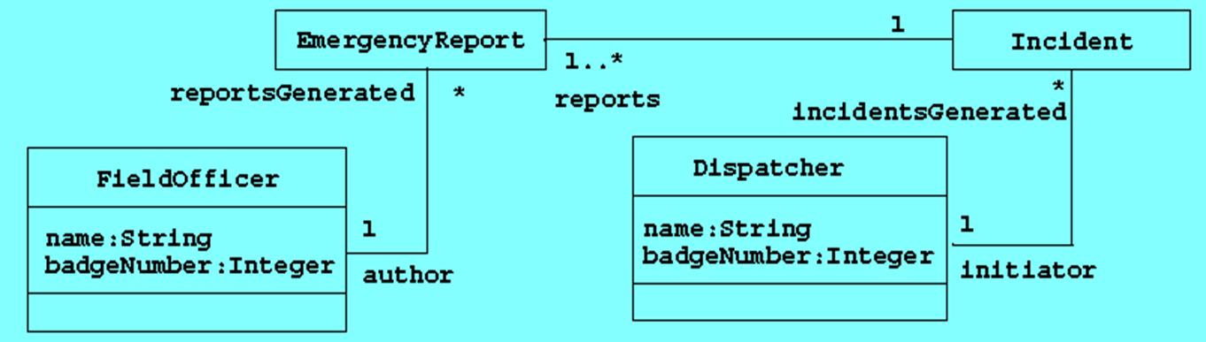
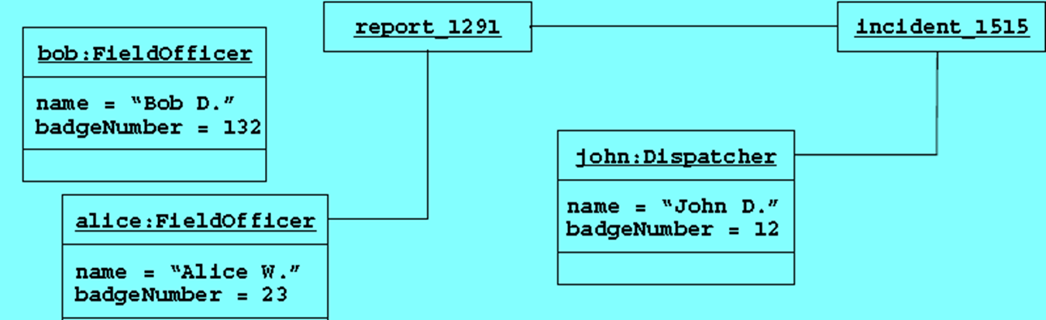
An example of a UML object diagram

Slide 51
Actor vs Instances
What is the difference between an actor , a class and an instance?
Actor:
  An entity outside the system to be modeled, interacting with the system (“Passenger”)
Class:
  An abstraction modeling an entity in the problem domain, must be modeled inside the system (“User”)
Object:
  A specific instance of a class (“Joe, the passenger who is purchasing a ticket from the ticket distributor”).
Dr.Thamer Al-Rousan

Slide 52
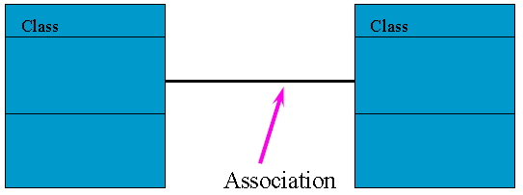
Class Associations
A link represents a connection between two objects.
Associations are relationships between classes and represent groups of links.
Each end of an association can be labeled by a string called role.
  roles allows us to distinguish multiple associations originating from a class.
  roles clarify the purpose of the association.
The multiplicity of an association end denotes how many objects the source object can legally reference.
Dr.Thamer Al-Rousan

Slide 53
1-to-1 and 1-to-many Associations
Country
Has-capital
City
1
1
name:String
name:String
One-to-one association
Point
Polygon
1
*
1
*
x: Integer
draw()
y: Integer
One-to-many association
Dr.Thamer Al-Rousan

Slide 54
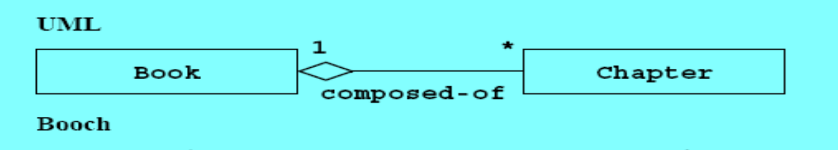
Aggregation
An aggregation is a special case of association denoting a “consists of” hierarchy.
The aggregate is the parent class, the components are the children class.
An aggregation is denoted by a simple line with a diamond at the container end of the association

Slide 55
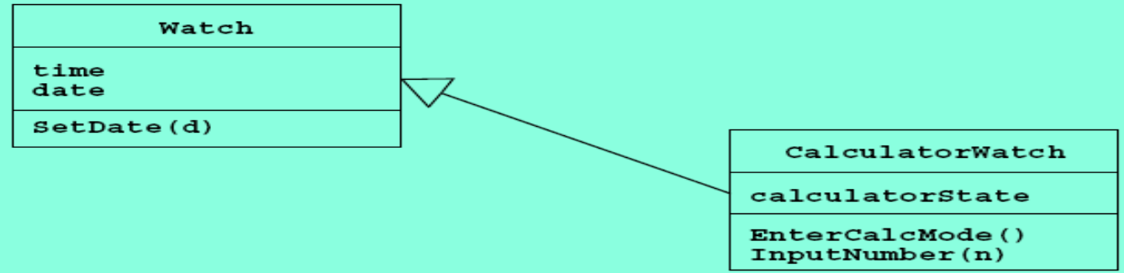
Generalization
This type of relationship between a base class and a refined class is called generalization.
An inheritance relationship is displayed by a line terminated with a triangle. The triangle points to the superclass, and the other end is attached to the subclass.
The children classes inherit the attributes and operations of the parent class.
Inheritance simplifies the model by eliminating redundancy.
Dr.Thamer Al-Rousan

Slide 56
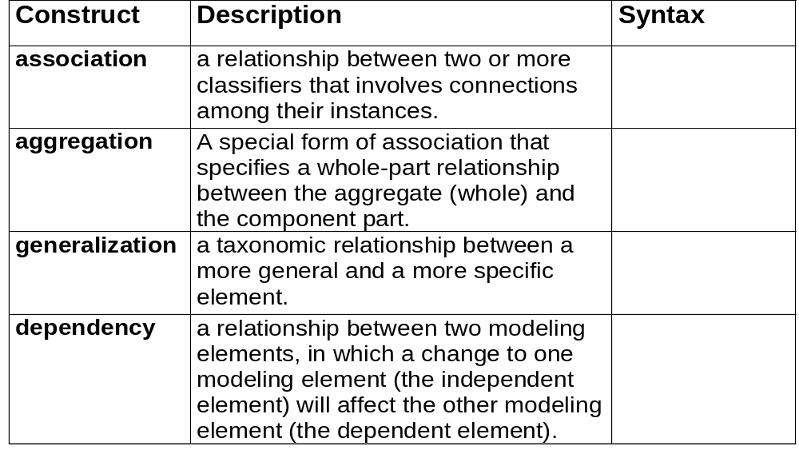
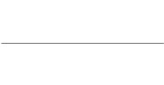




Structural Modeling: Core Relationships

Slide 57
Qualified Association
Without qualification
1
*
File
Directory
filename
a qualifier
With qualification
1
0…1
Directory
filename
File
Qualification is a technique for reducing multiplicity by using keys, also called a qualifier. Associations with a 0..1 or 1 multiplicity are easier to understand than associations with a 0..n or 1..n multiplicity.

Slide 58
Packages
A package is a UML mechanism for organizing elements into groups (usually not an application domain concept)
Packages are the basic grouping construct with which you may organize UML models to increase their readability.
A complex system can be decomposed into subsystems, where each subsystem is modeled as a package
DispatcherInterface
Notification
IncidentManagement
Dr.Thamer Al-Rousan

Slide 59
class diagram
Class diagrams describe the system in terms of objects, classes, attributes, operations, and their associations.
During analysis, software engineers build class diagrams to formalize application domain knowledge
The classes that are shown on a class diagram will depend on the
  phase of the development process and
  the level of detail being considered
Dr.Thamer Al-Rousan

Slide 60
Sequence Diagram
  Sequence diagrams are used to Describe the dynamic behavior between actors and the system and and to visualize the communication between objects.
They are useful for identifying additional objects that participate in the use cases. We call objects involved in a use case participating objects.
A sequence diagram represents the interactions that take place between these objects.
An object requests the execution of an operation from another object by sending it a message.
Dr.Thamer Al-Rousan

Slide 61
Sequence Diagram
Sending a message is the mechanism by which the sending object requests the execution of an operation in the receiving object.
The message is composed of a name and a number of arguments.
The receiving object matches the name of the message to one of its operation and passes the arguments to the operation, which in turn may send messages to other objects.
Results are returned to the sending object.
Dr.Thamer Al-Rousan

Slide 62
Sequence Diagram
Object behavior is specified by operations.
A set of operations represents a service offered by a particular class.
The operations of a class are the public services that the class offers.
The methods of its class are the implementations of these operations
Dr.Thamer Al-Rousan

Slide 63
UML sequence diagrams
Used during requirements analysis
  To refine use case descriptions
  to find additional objects (“participating objects”)
Used during system design
  to refine subsystem interfaces
Classes are represented by columns
Messages are represented by arrows and may contain arguments
Activations are represented by narrow rectangles
Lifelines are represented by dashed lines
Passenger
TicketMachine
selectZone()
insertCoins()
pickupChange()
pickUpTicket()
Dr.Thamer Al-Rousan

Slide 64
UML first pass: Sequence diagram
Actor
Object
:WatchUser
:Watch
:LCDDisplay
:Time
pressButton1()
blinkHours()
pressButton1()
blinkMinutes()
Message
pressButton2()
incrementMinutes()
refresh()
pressButtons1And2()
commitNewTime()
stopBlinking()
Activation
Lifeline
Sequence diagrams represent the behavior as interactions
Dr.Thamer Al-Rousan

Slide 65
Nested messages
Passenger
ZoneButton
TarifSchedule
Display
selectZone()
lookupPrice(selection)
price
Dataflow
displayPrice(price)
…to be continued...
The source of an arrow indicates the activation which sent the message
An activation is represented by a rectangle from which other messages can begin.
The length of the rectangle represents the time the operation is active.
Horizontal dashed arrows indicate data flow
Vertical dashed lines represents time from top to bottom (Lifelines).

Slide 66
Iteration & condition
…continued from previous slide...
Passenger
ChangeProcessor
CoinIdentifier
Display
CoinDrop
*
insertChange(coin)
lookupCoin(coin)
Iteration
price
displayPrice(owedAmount)
Condition
[owedAmount<0] returnChange(-owedAmount)
…to be continued...
Iteration is denoted by a * preceding the message name
Condition is denoted by boolean expression in [ ] before the message name

Slide 67
Creation and destruction
…continued from previous slide...
Passenger
ChangeProcessor
Creation
createTicket(selection)
Ticket
print()
free()
Destruction
Creation is denoted by a message arrow pointing to the object.
Destruction is denoted by an X mark at the end of the destruction activation.
In garbage collection environments, destruction can be used to denote the end of the useful life of an object.

Slide 68
Sequence Diagram Summary
UML sequence diagram represent behavior in terms of interactions.
Useful to find missing objects.
Time consuming to build but worth the investment.
Complement the class diagrams (which represent structure).
Dr.Thamer Al-Rousan

Slide 69
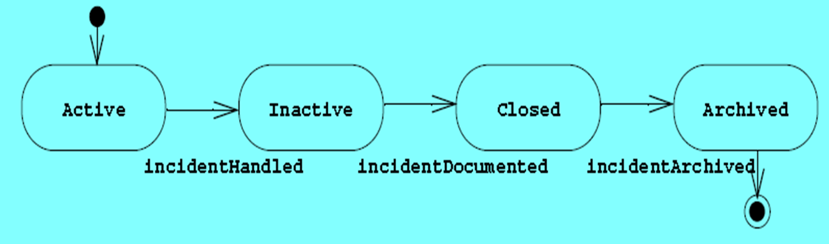
Statechart
Statechart diagrams describe the behavior of an individual object as a number of states and transitions between these states.
A state is a condition that an object satisfies.
A transition represents a future state the object can move to and the conditions associated with the change of state
Dr.Thamer Al-Rousan

Slide 70
Statechart
A state is represented by a rounded rectangle.
A transition is depicted by arrows connecting two states.
States are labeled with their name.
A small solid black circle indicates the initial state.
A circle surrounding a small solid black circle indicates a final state.
Dr.Thamer Al-Rousan

Slide 71
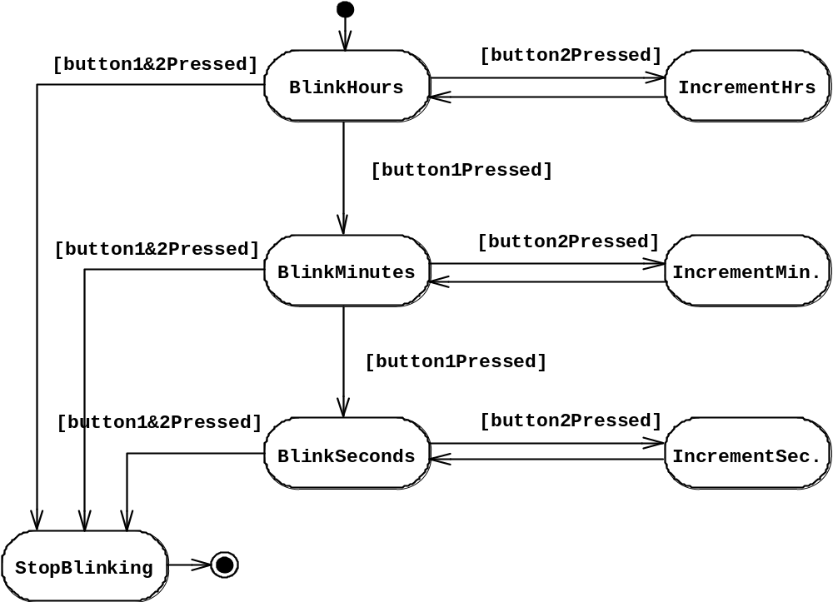
State Chart Diagrams
Initial state
State
Event
Transition
Final state
Represent behavior as states and transitions
Dr.Thamer Al-Rousan

Slide 72
Statechart
Statechart diagrams represents different information than the sequence diagram:
  The sequence diagram focuses on the messages exchanged between objects as a result of external events created by actors.
  The statechart diagram focuses on the transitions between states as a result of external events for an individual object.
Statechart diagrams can also be used during system and object design to describe solution domain objects with interesting behavior.
Dr.Thamer Al-Rousan

Slide 73
Activity Diagrams
The outgoing transitions are activated by the completion of an action associated with the state. This is called an action state.
  the name of a state denotes a condition,
  whereas the name of an action state denotes an action.
Event causes
State transition
Active
Inactive
Closed
Archived
Incident-
Handled
Incident-
Documented
Incident-
Archived
Dr.Thamer Al-Rousan

Slide 74
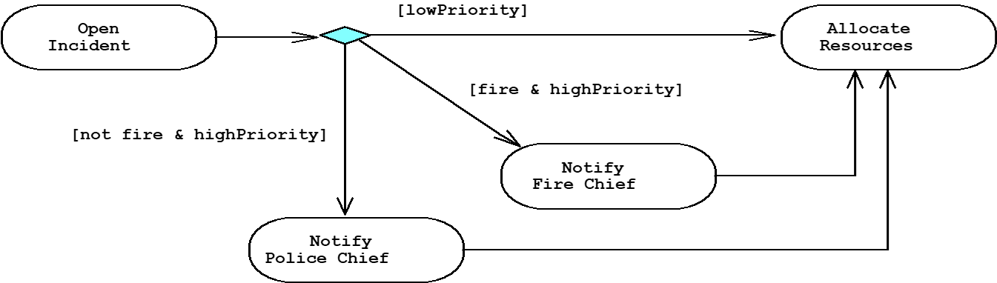
Activity Diagram: Modeling Decisions
Decisions are branches in the control flow. They indicate alternative transitions based on a condition of the state.
  Decisions are showed by a diamond with one or more incoming arrows and two or more outgoing arrows.
  The outgoing arrows are labeled with the conditions that select a branch in the control flow.
  The set of all outgoing transitions from a decision represents the set of all possible outcomes.
Dr.Thamer Al-Rousan

Slide 75
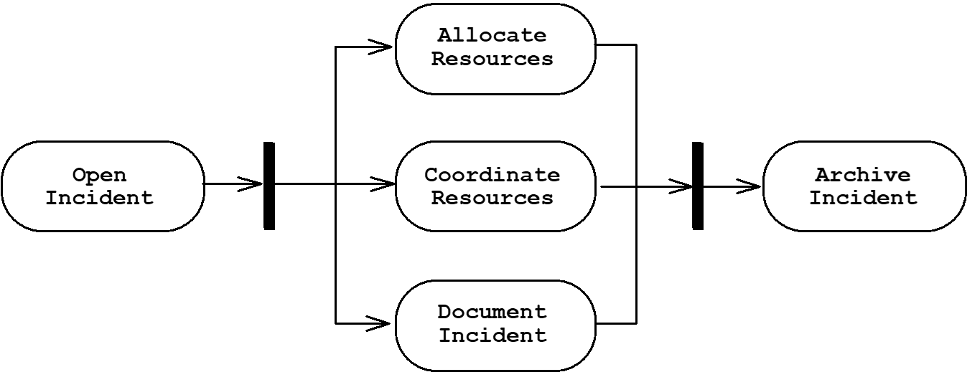
Activity Diagrams: Modeling Concurrency
Synchronization of multiple activities
Splitting the flow of control into multiple threads
Splitting
Synchronization
Dr.Thamer Al-Rousan

Slide 76
Activity Diagrams: Swimlanes
Actions may be grouped into swimlanes to denote the object or subsystem that implements the actions.
Allocate
Dispatcher
Resources
Open
Coordinate
Archive
Incident
Resources
Incident
FieldOfficer
Document
Incident
Dr.Thamer Al-Rousan

Slide 77
Example
Draw an activity diagram that represents the making of a cup of tea. The initial three activities are Fill kettle with water, Find cup and Find tea bag and they must be performed in parallel. When the Find cup and Find tea bag are completed the activity Place tea bag in cup can start. The kettle must have boiled and the tea bag must have been placed in the cup before the activity Add water to cup can begin. If milk is required then activity Add milk should be performed
Dr.Thamer Al-Rousan

Slide 78
The Class Diagram Through the Development Process
Class diagrams can be used throughout the development lifecycle, ranging:
  during requirements analysis to model problem domain concepts
  during system design to model subsystems and interfaces
  during object design to model classes.
to show the class structure of that system.
Dr.Thamer Al-Rousan

Slide 79
UML first pass: Class diagrams
Class diagrams represent the structure of the system
Association
Class
Multiplicity
Watch
1
1
1
1
2
1
2
1
PushButton
LCDDisplay
Battery
load
Time
now
state
blinkIdx
blinkSeconds()
blinkMinutes()
blinkHours()
stopBlinking()
referesh()
push()
release()
Attribute
Operations
Dr.Thamer Al-Rousan

Slide 80
UML Summary
UML provides a wide variety of notations for representing many aspects of software development
  Powerful, but complex language
  Can be misused to generate unreadable models
  Can be misunderstood when using too many exotic features
For now we concentrate on a few notations:
  Functional model: Use case diagram
  Object model: class diagram
  Dynamic model: sequence diagrams, statechart and activity diagrams
Dr.Thamer Al-Rousan

